Slide 1
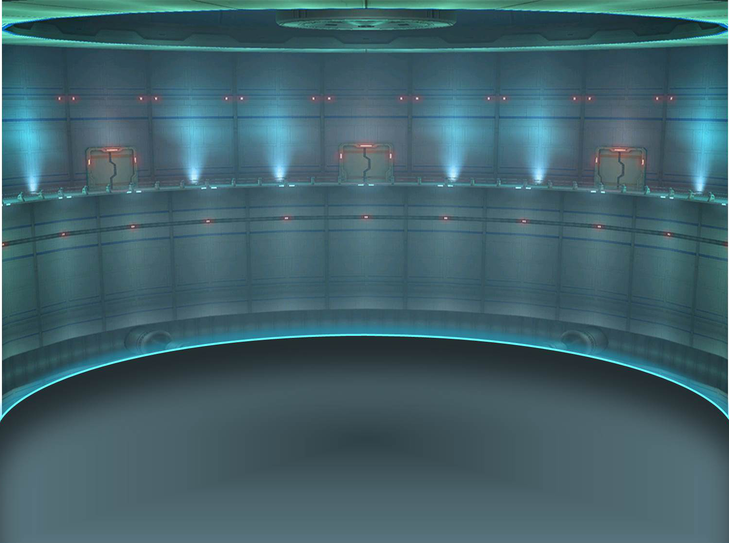

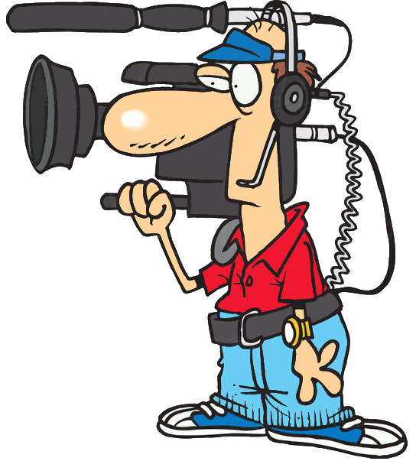
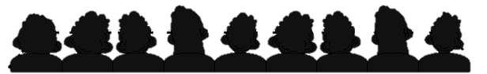
VOTE FOR ME
REPORTED SPEECH

Slide 2
I’m going to improve the traffic in the city this very month.

Slide 3
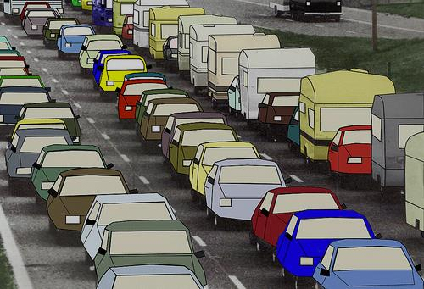
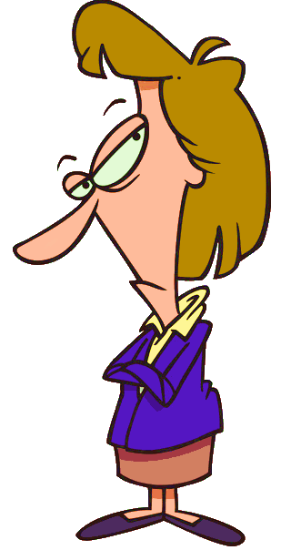
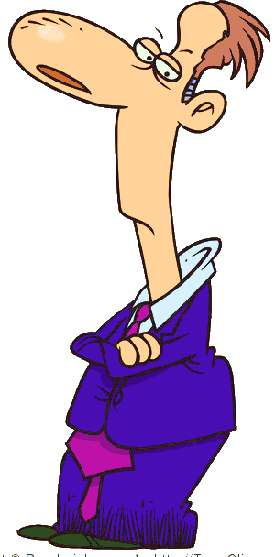
Two years later …
He said that he was going to improve the traffic in the city that very month.
He said that …
What did he say?

Slide 4
I will pay higher salaries.

Slide 5
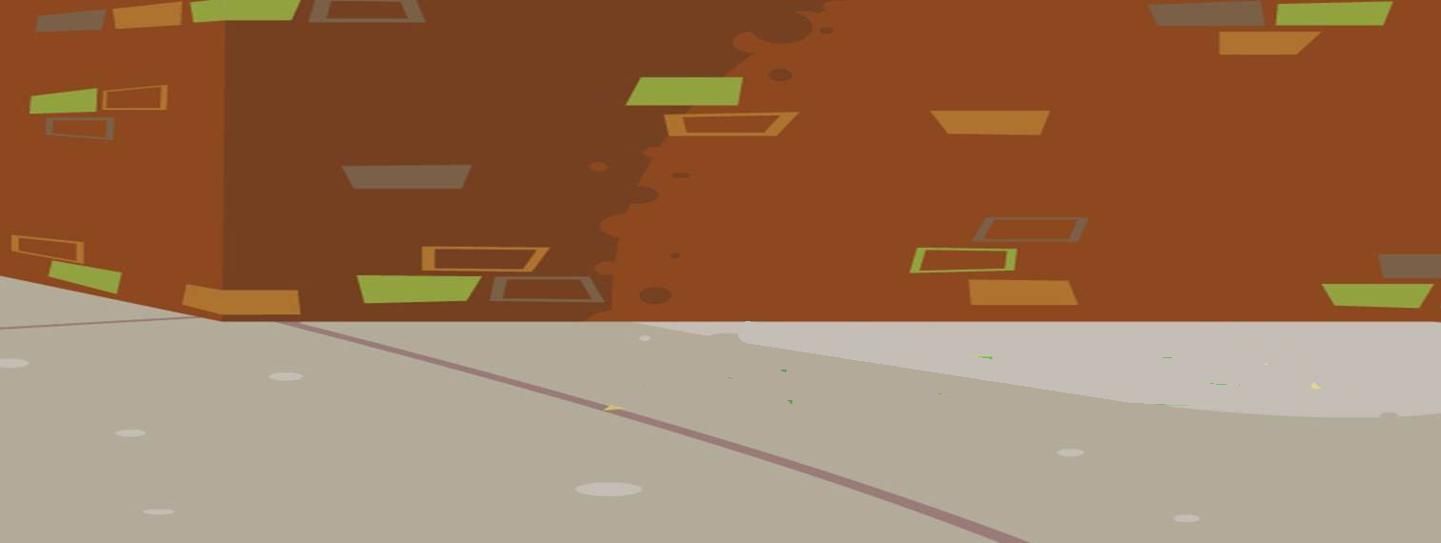
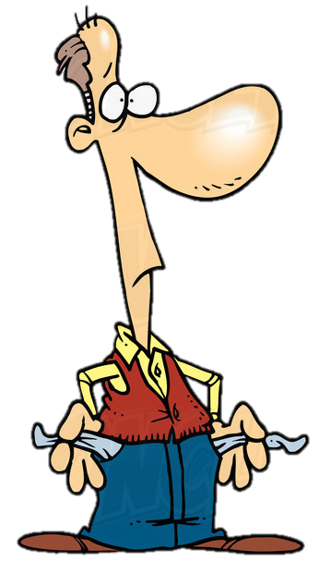
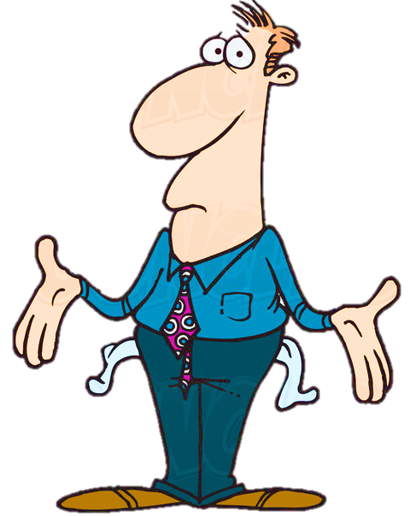

Two years later …
He said that he would pay higher salaries.
He said that …
What did he say?

Slide 6
I’m going to clean up the parks this year.

Slide 7

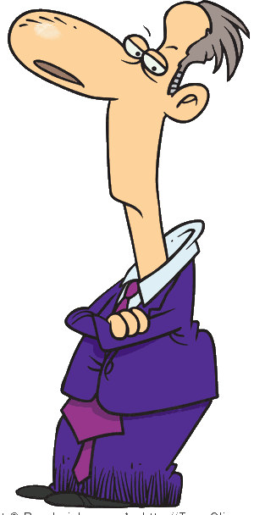
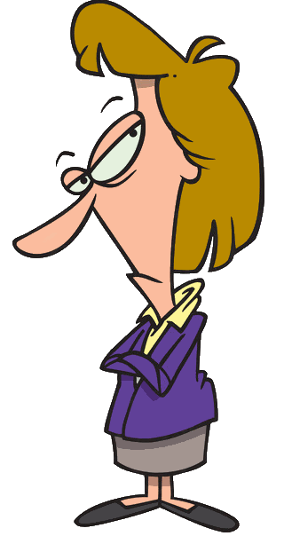

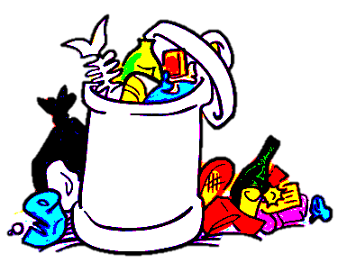

Two years later …
He said that he was going to clean up the parks that year.
He said that …
What did he say?

Slide 8
I will build a new bridge over the river.

Slide 9

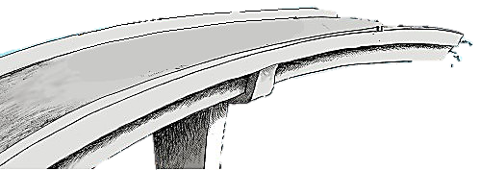
Two years later …
He said that he would build a new bridge over the river.
He said that …
What did he say?

Slide 10
I’m going to restore the castle.

Slide 11


Two years later …
He said that he would restore the castle.
He said that …
What did he say?

Slide 12
I will buy new buses for the city transport.

Slide 13
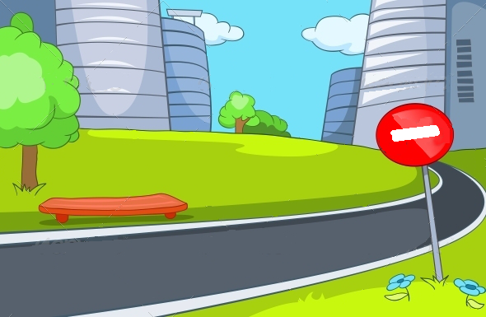

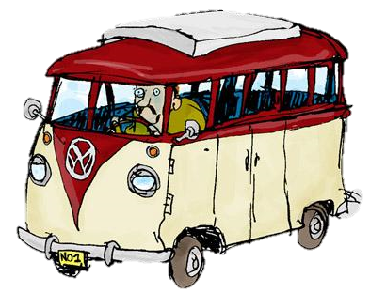
Two years later …
What did he say?
He said that …
He said that he would buy new buses for the city transport.

Slide 14
I’m going to eliminate pollution.

Slide 15
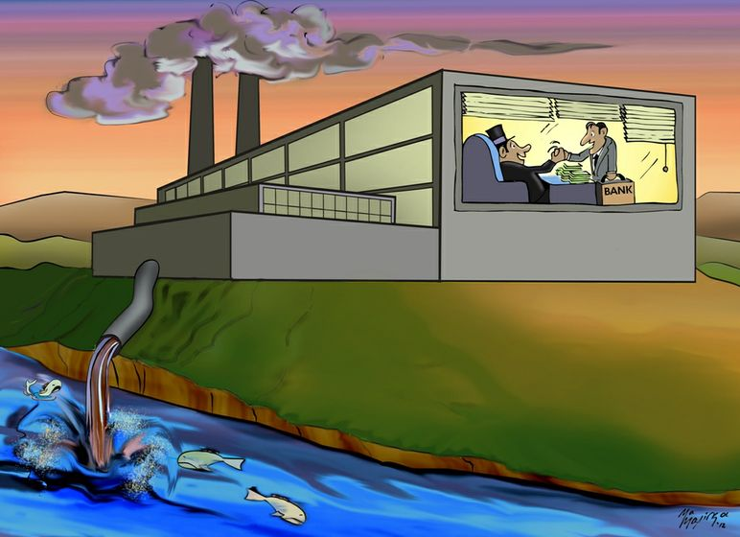
Two years later …
He said that …
He said that he was going to eliminate pollution.
What did he say?

Slide 16
I'm not here to get rich.

Slide 17

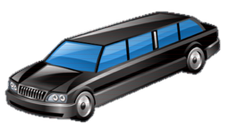
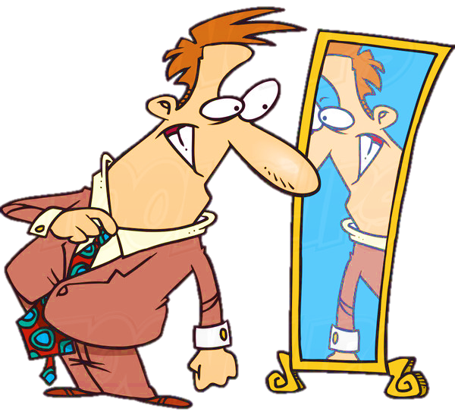
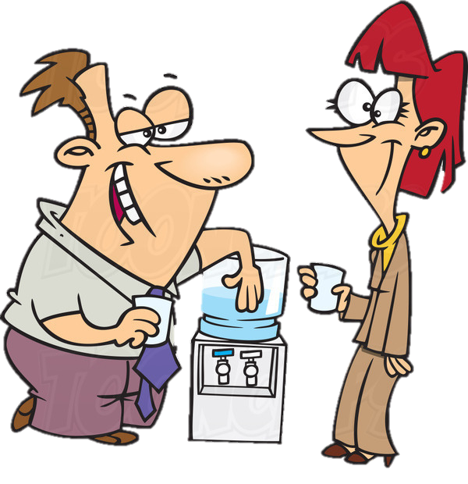
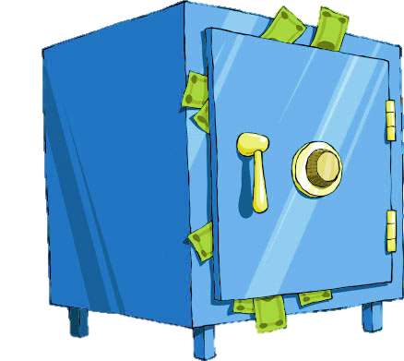
Two years later …
He said that …
He said that he wasn’t here to get rich.
What did he say?

Slide 18
I will work hard for the city.

Slide 19

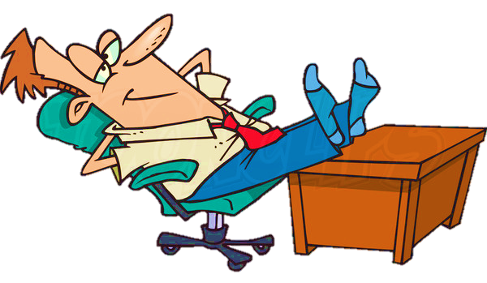
Two years later …
He said that …
He said that he would work hard for the city.
What did he say?

Slide 20
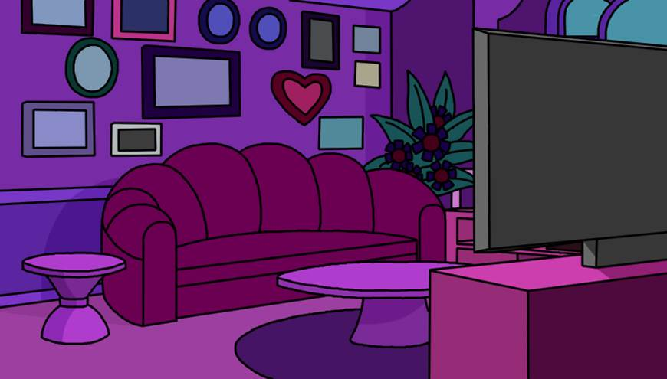
Politicians!
Vote for me!

